Slide 1

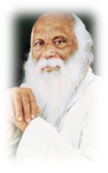
Rayat shikashan Santa's
Arts , Science and commerce college
Ramanandnagar (Burli).
Department
Of
Statistics

